Slide 1
MEDICAL
HEALTH PRIVACY
BLOCKCHAIN TO PRESERVE INTEGRITY OF MEDICAL RECORDS

Slide 2
PROBLEM STATEMENT:
When users submit their medical health records to some hospitals or some private organisations,there is a chance that some data might be tampered.Since the medical health related data is very sensitive,the integrity and privacy of the data must be preserved.Also to verify the user the veriﬁer might need some other sensitive information like ssn id or pan card number
,etc of the user,so we need to ensure that we authenticate the user properly without knowing those ssnid or any sensitive data of the user using zero knowledge proofs.

Slide 3
Blockchain introduction
A blockchain is a digital and distributed ledger of transactions, recorded and replicated in real-time across a network of computers or nodes. Every transaction must be cryptographically validated via a consensus mechanism executed by the nodes before being permanently added as a new “block” at the end of the “chain.” There is no need for a central authority to approve the transaction, which is why blockchain is sometimes referred to as a peer-to-peer trustless mechanism.
Blockchain can be thought of as a linked list with each node containing multiple transactions. Each transaction has a hash that depends on the previous transactions hash as well. So we can see that the order of transactions is important. If we were to change one transaction somewhere, it would have a ripple effect and change the hash of all subsequent transactions. This is one of the reasons why blockchain is a powerful medium for storing transactions.

Slide 4
(cntd)
The placing of a transaction in a block is called a successful conclusion to a proof of work challenge, and is carried out by special nodes called miners. Proof of Work is a system that requires some work from the service requester, usually meaning processing time by a computer. Producing a proof of work is a random process with low probability, so normally a lot of trial and error is required for a valid proof of work to be generated. When it comes to Bitcoins, hash is what serves as a proof of work. Miners on a Blockchain are nodes that produce blocks by solving proof of work problems. If a miner produces a block that is approved by an electronic consensus of nodes then the miner is rewarded with coins. This essentially is the crux of blockchain. Proof of Work is what is keeping all transactions on the blockchain secure and protecting it from malicious attempts to alter these transactions.

Slide 5
How blockchain solves this problem?
We can store the medical health records of the user at multiple nodes (ie owned by a set of hospitals or organisations).
So we store the data in a distributed environment and data addition is governed by the consensus mechanism implemented by the designer.
We store the medical health record of any user as a transaction.
Then the user sends this transaction to transaction pool from where the validators will verify the transaction and add this to the block which that the validator proposes.

Slide 6
(CNTD)
Then every node tries to propose a block but since this could lead to race condition the consensus mechanism comes for the protection .
Only the ﬁrst node to compute the proof of work will propose the block .
Every other node will validate this block and update the local blockchains stored in them.
And whenever there is forking of blockchain then a rule known as longest chain rule is applied to know the correct chain of blockchain

Slide 7
How and where do we use zkp?
So when the user submits their data as a transaction,since there could also be a possibility of malicious user submitting random and unwanted data which is not desired,we would require the user to authenticate before inserting any record.
But to verify we need some ssn id or pan card number or debit card number for payment processing etc,which the user wouldn’t want to share with the veriﬁer.
So here we apply zero knowledge proof to verify the user and to prove the authenticity of the user.

Slide 8
Zkp in our code
In our project, zero-knowledge protocol is used for verifying the individual transactions (medical records).
Client chooses a random number 0≤r<p-1 and sends it to server as
h=g^rmod(p)
server receives h and sends back a random bit b (could be 0/1).
client sends s=(r+bx)mod(p-1) to Bob.
server computes g^smod(p) which should equal hy^bmod(p).

Slide 9
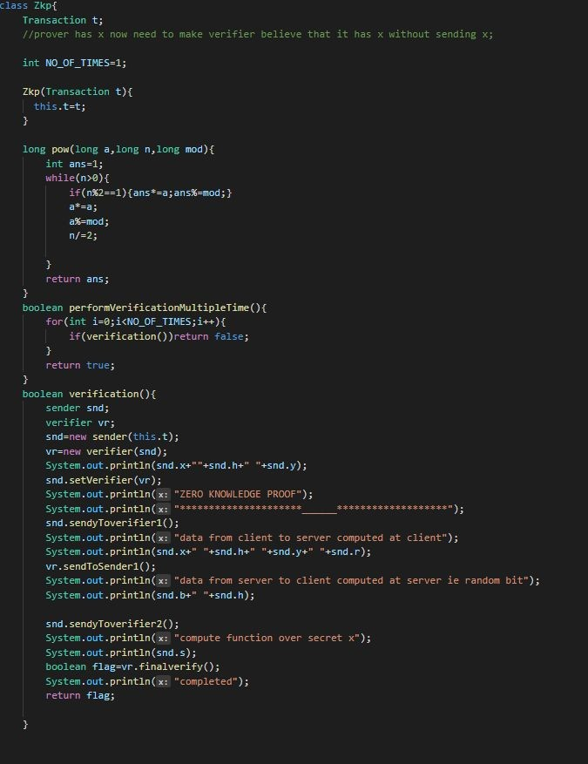
Zkp implementation:

Slide 10
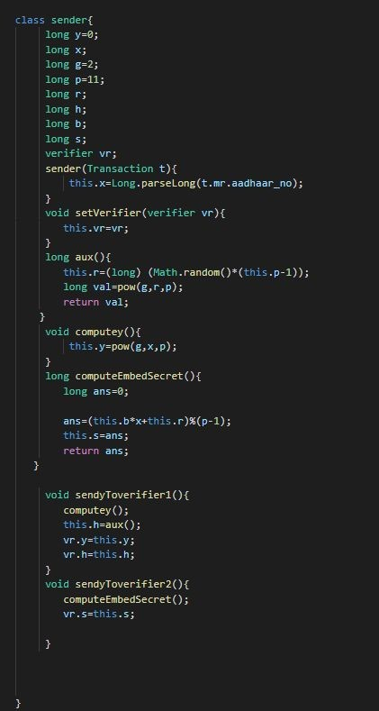

Slide 11
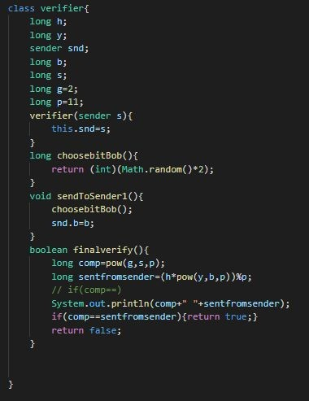

Slide 12
UML Diagrams

Slide 13
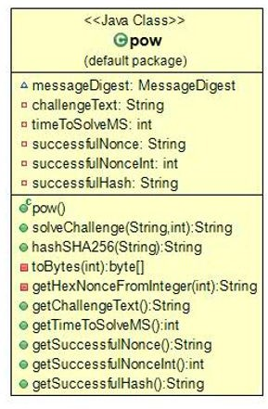
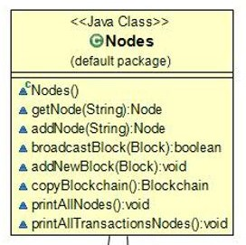

Slide 14
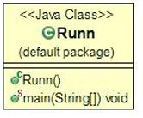
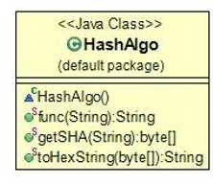
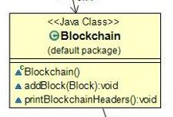
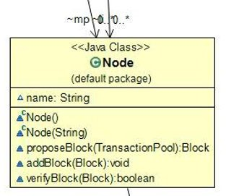
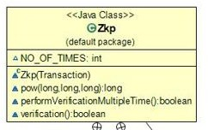

Slide 15
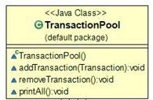
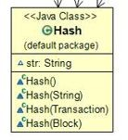
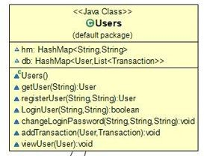

Slide 16
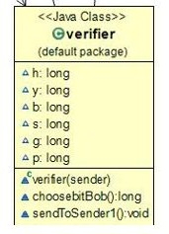
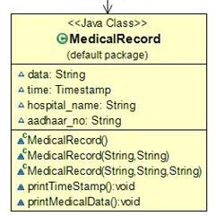
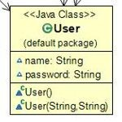

Slide 17
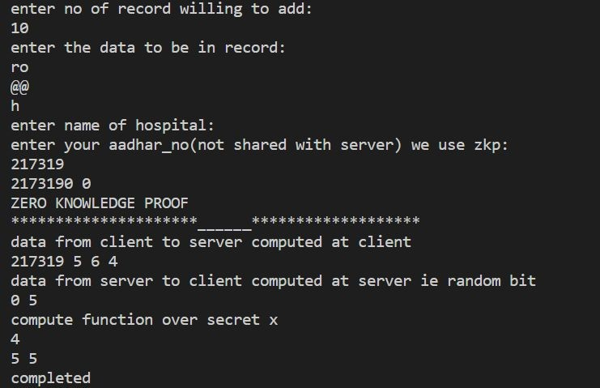
ScreenShots

Slide 18
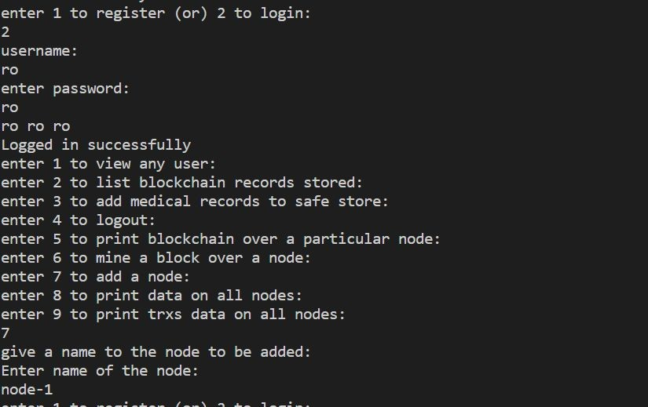

Slide 19
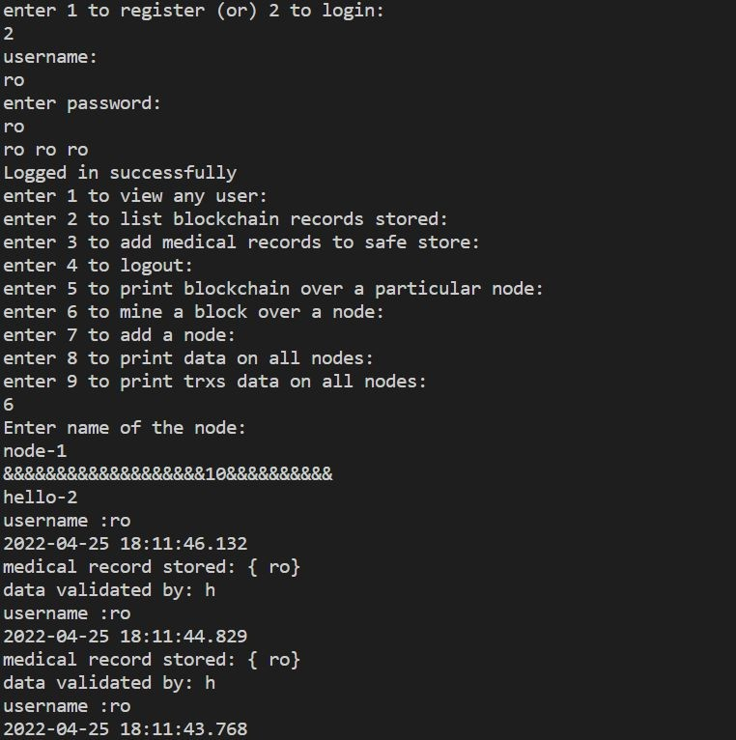


Slide 20

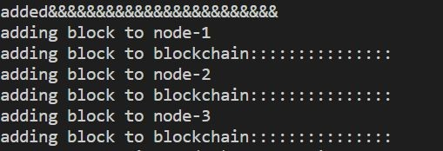

Slide 21
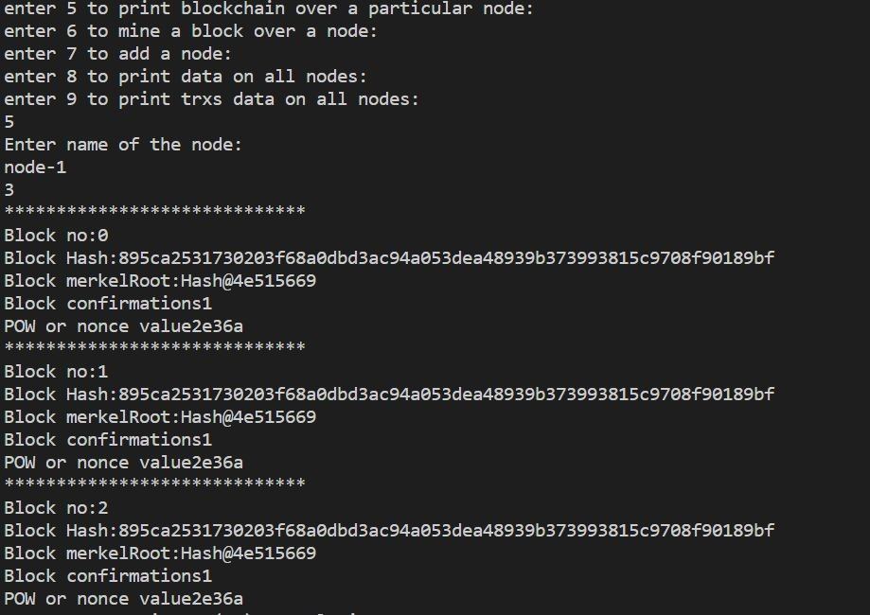

Slide 22
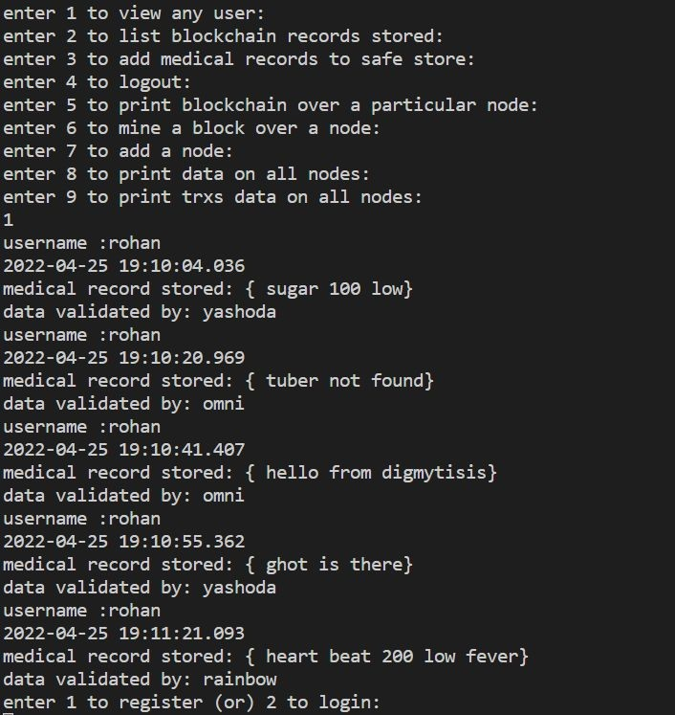

Slide 23
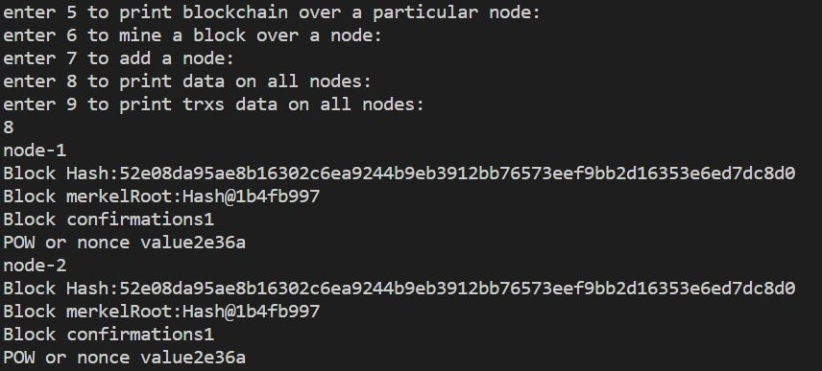

Slide 24
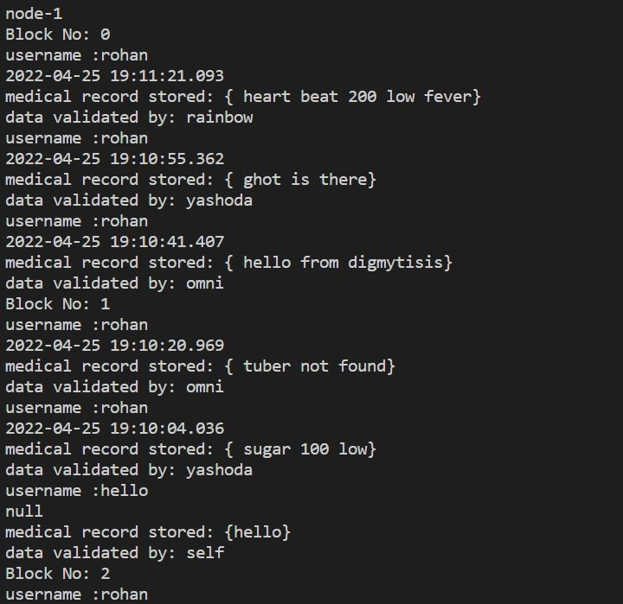

Slide 25
